Slide 1
Problem Statement:
Check if parentheses are balanced using Stack
Input: exp = “[()]{}” Output: Balanced
Input: exp = “[(){}” Output: Not Balanced

Slide 2
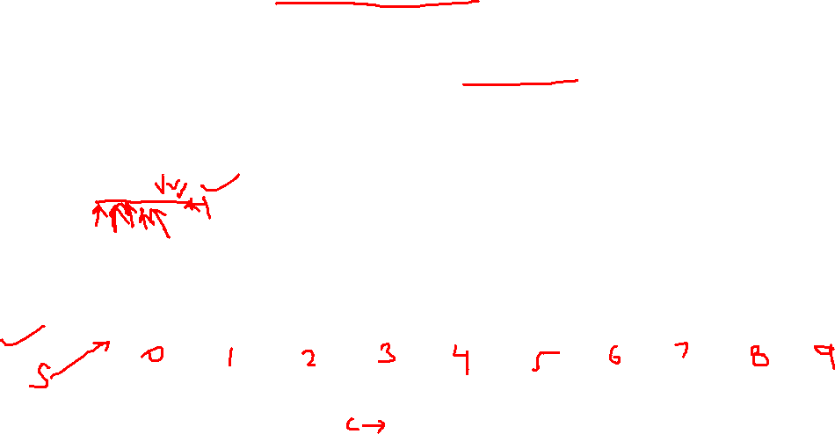
Logic
1) Create an empty character stack.
2) Traverse the string
If the current character is a starting bracket (‘(‘ or ‘{‘ or ‘[‘) then push it to stack.
If the current character is a closing bracket (‘}’, ‘]’, ‘)’), then pop the element from the stack and compare with current bracket. If it is not matching, it is not balanced.
One by one pop all characters from stack and put them back to string.
3) After complete traversal, if there is any bracket left in stack then “not balanced”
Input: exp = “{ } { [ ( ) ] ( ) }”
{ , [, (
} , ], )

Slide 3
Demo Code

